Slide 1
Automatic Lens Smear Detection
JAGRUTI VICHARE (A20378092)
NAVEENKUMAR SIVASUBRAMANIAN (A20378088)
SABAREESH SURESH (A20396634)

Slide 2
Problem Statement
Input : A sequence of Street view images.
Output : A mask on the smear on the lens.

Slide 3
Approach
To encounter this challenge the steps followed has been briefly listed.
Step 1 : Perform Image averaging on the sequence of images taken as input and smoothen using Gaussian Blur/Gaussian filter.
Step 2 : Apply Adaptive Thresholding to the output of Gaussian filtered image.
Step 3 : Use Canny Edge detector to detect the edges of the smear.
Step 4 : Draw contours across the edges detected to highlight the smear.

Slide 4
Step 1 : Image Averaging
Image averaging is the technique used for the removal of random noise caused due to random fluctuations in the video or a captured image.
It is computed based on the arithmetic mean of pixel values of the sequence of the images that is given as an input.
The resulting image after averaging reduces the noise and increases the signal to noise ratio(SNR) enhancing the bit depth of the image, making the signal component to have a strong influence over the noise component.

Slide 5


Averaged Image
The resulting output Fig.1 depicts the averaged image after summation of all images from cam_3.
Fig.2 shows the smoothening of the image taking averaged image as input.
Fig.1. Averaged Image
Fig.2. Gaussian filtered Image

Slide 6
Step 2 : Adaptive Thresholding
Adaptive thresholding typically takes a grayscale or color image as input and, it outputs a binary image representing the segmentation by calculating the threshold for each pixel in an image.
Adaptive Thresholding is used to segment an image by setting all pixels whose intensity values are above a threshold to a foreground value and all the remaining pixels to a background value.

Slide 7

Adaptive Threshold image
The Fig.3 is the result after performing adaptive thresholding on output of Gaussian filtered image.
Fig.3. Adaptive threshold image

Slide 8
Step 3 : Edge Detection
Canny edge detection is a technique used to extract essential structural information from an image and reduces the amount of data to be processed.
The Canny detector is use to catch accurately as many possible edges in an image by tracking across the edge points through localizing the center of edge of an image.
The Canny edge detection prevents the false detection and prevention of noise through its precise edge points.

Slide 9
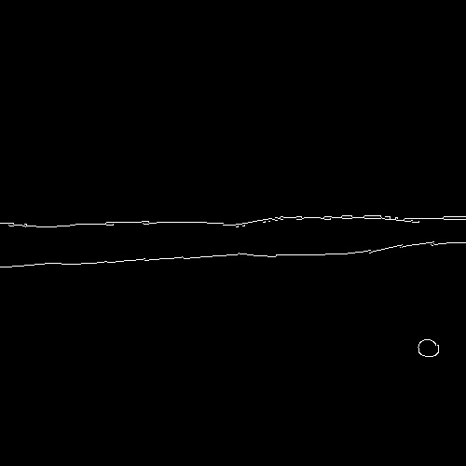
Step 4: Edge Detection
The Fig.4 is the image detecting the outer edges of smear of the adaptive thresholding image.
Fig.4. Edge Detection

Slide 10
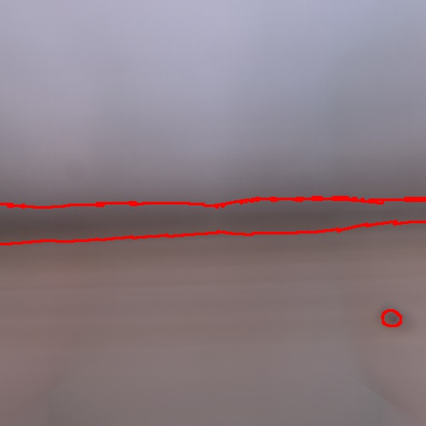
Step 4 : Smear Detection
The Fig.5 depicts the final result and the contour highlights the smear detected in the sequence of input images.
Fig.5 Smeared Image

Slide 11
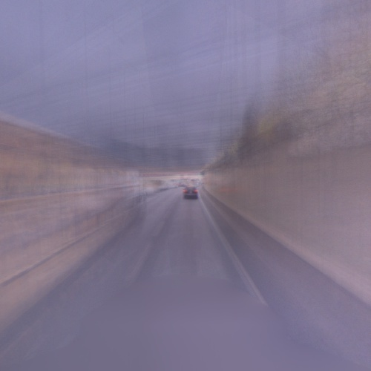


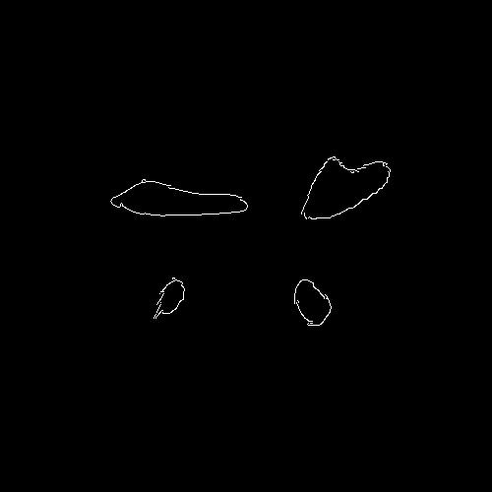
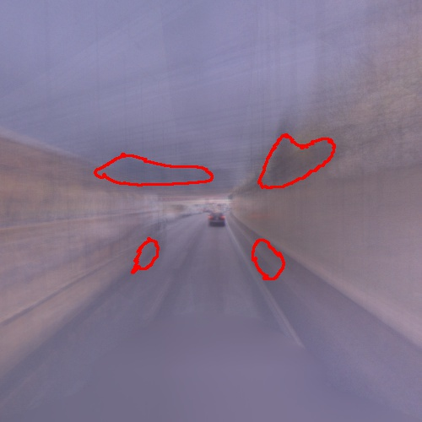
Result for limited images
For better understanding the script is executed with limited images and we get the following as the output.
Average
Gaussian
Threshold
Edge Detection
Final Output

